Slide 1

Leaders & Heroes
People who made a difference
Lecture # 7 - Sport

Slide 2

The World of Sport

Slide 3
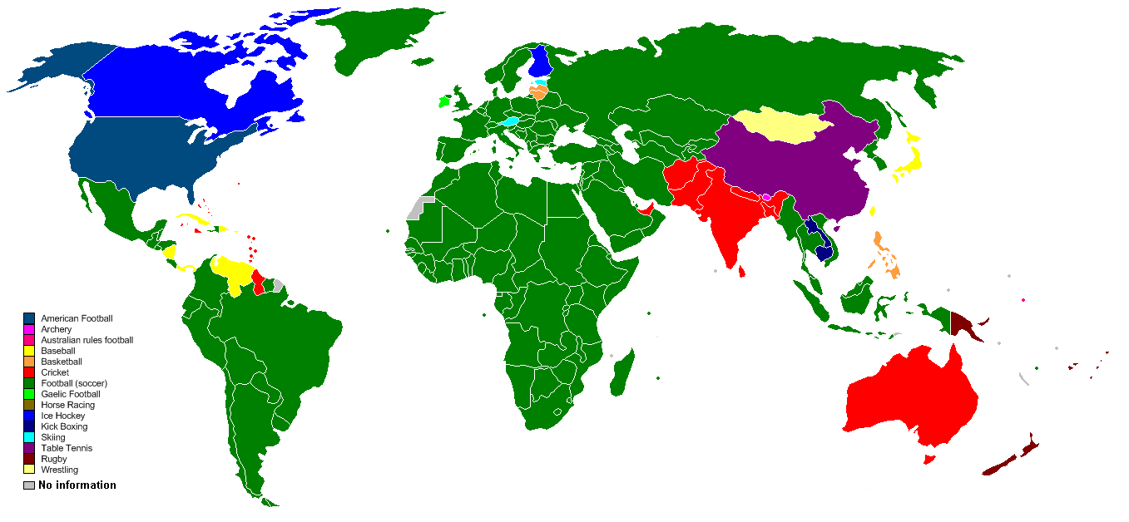
212 countries around the world UN only 192
265 million players actively involved in soccer around the world, roughly about 4 percent of the world's population
2014/18 FIFA World Cup™ reached 3.5 billion viewers, one billion watched final.

Slide 4





Slide 5
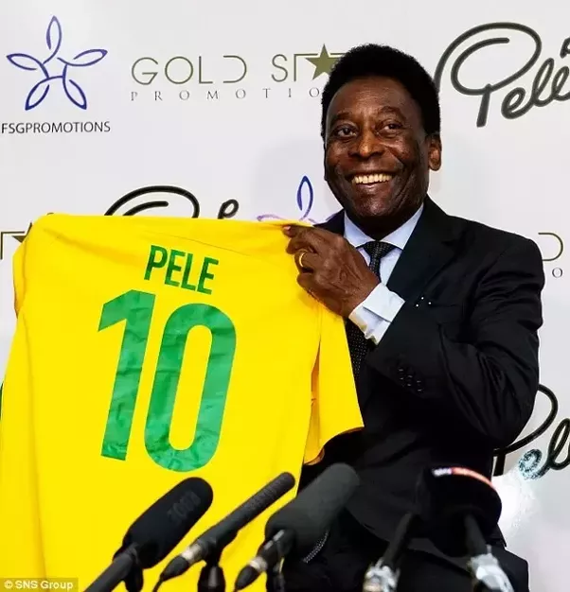
Best Ever Footballer

Slide 6
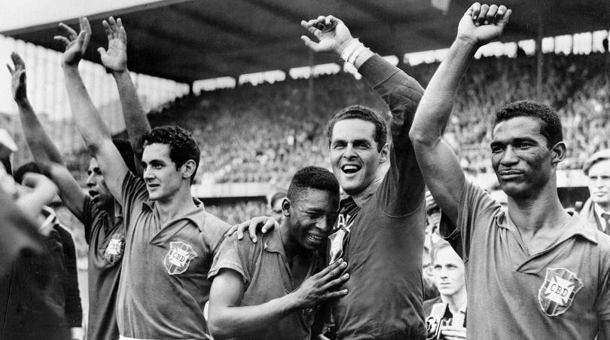
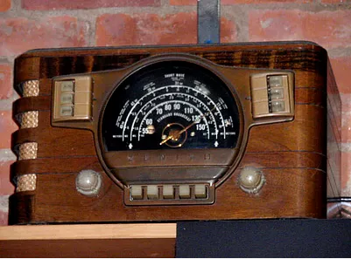
When I fall in love – It will be forever

Slide 7
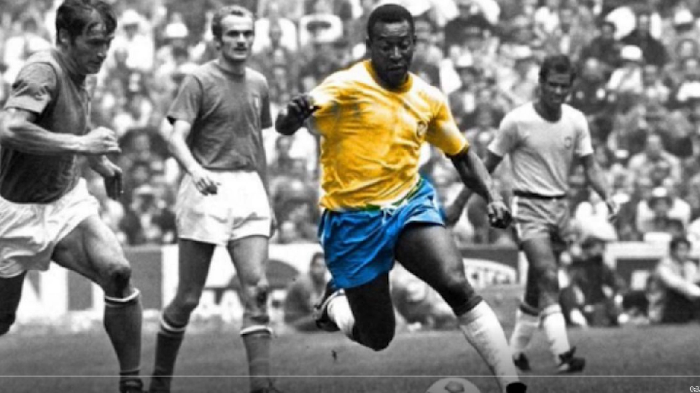

Slide 8
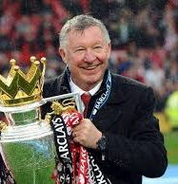

The Greatest Manager

Slide 9
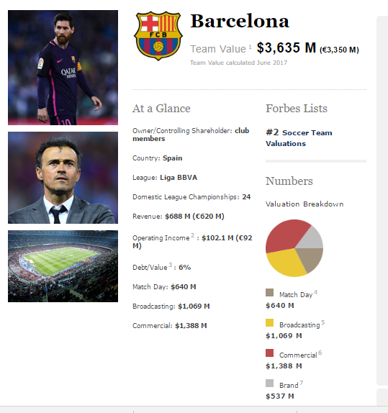
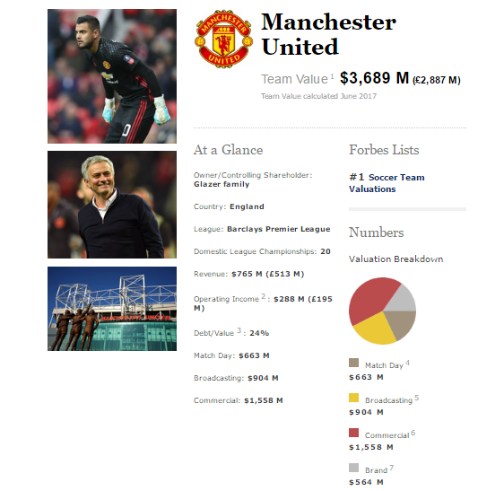

Slide 10
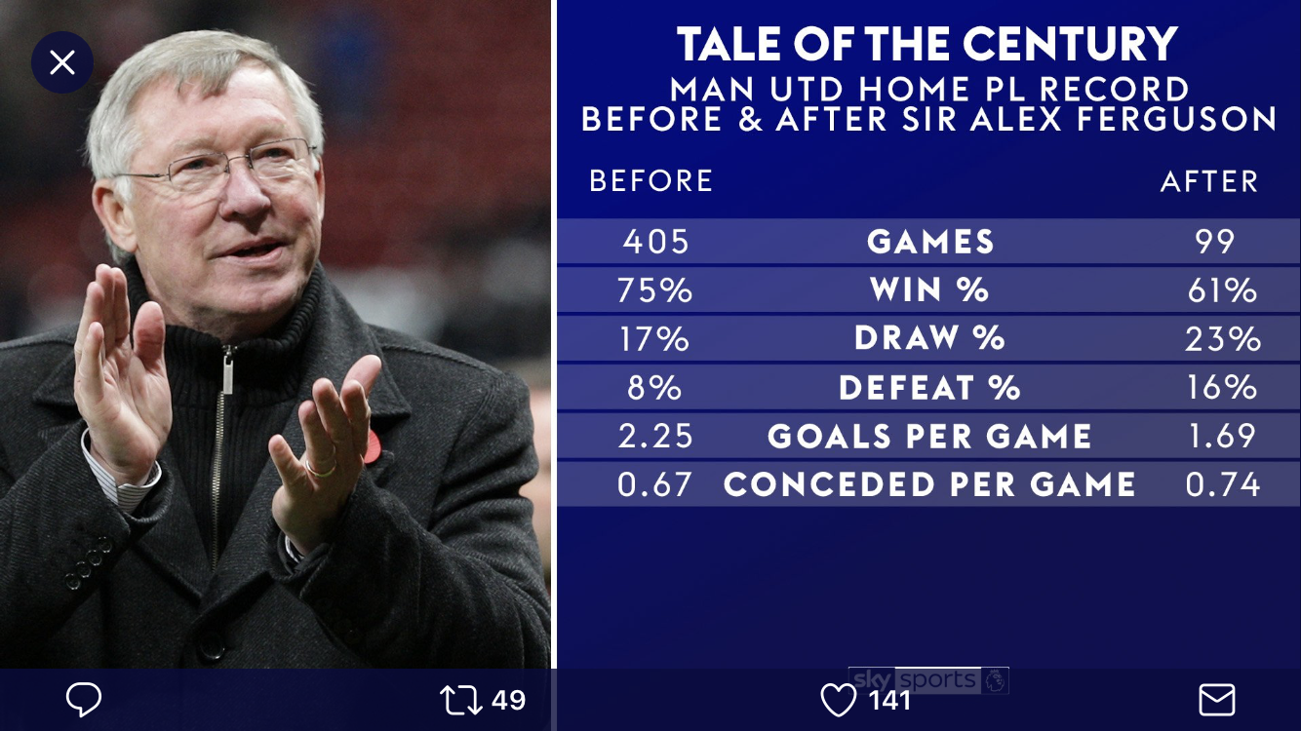

Slide 11
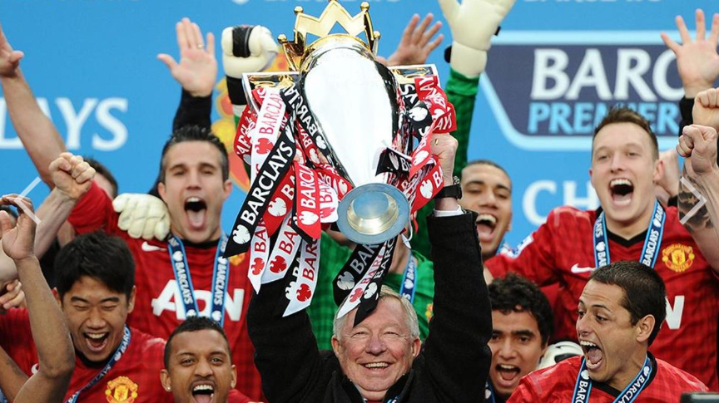

Slide 12
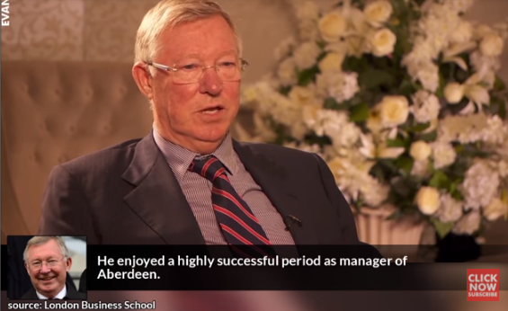
10 Rules for Success

Slide 13
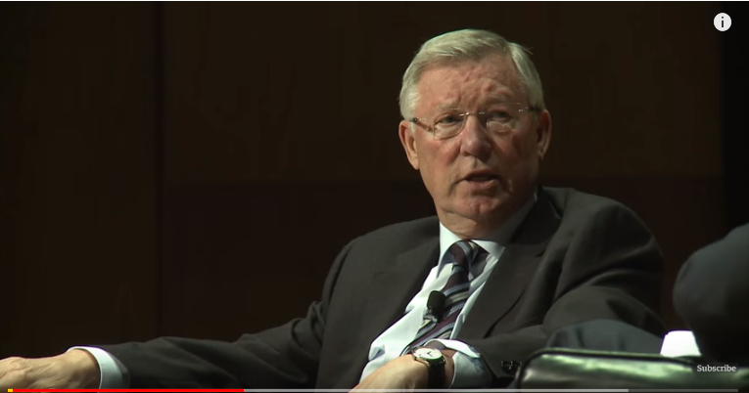
Communications

Slide 14

Sir Alex Ferguson’s Farewell Speech

Slide 15
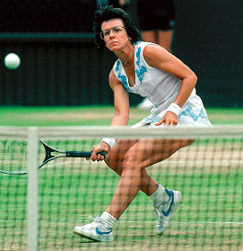
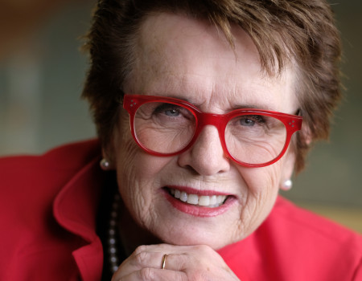
Broke Gender Barriers in Tennis and all other Sports

Slide 16
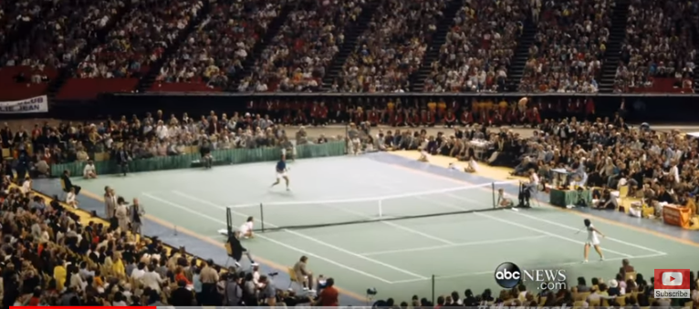
Battle of the Sexes

Slide 17
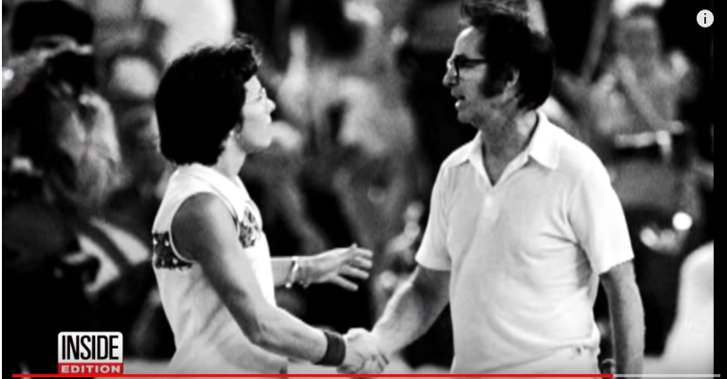

Slide 18
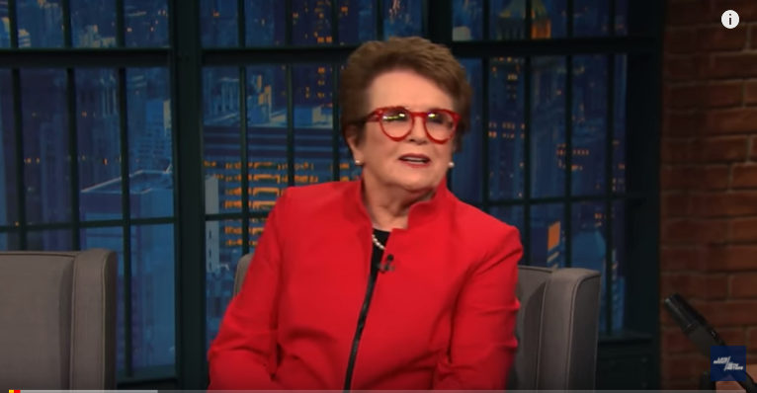

Slide 19
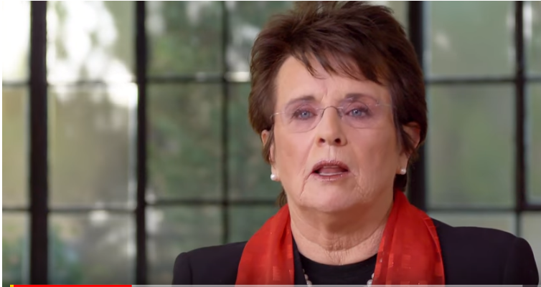
Billy Jean King on “Coming Out”

Slide 20
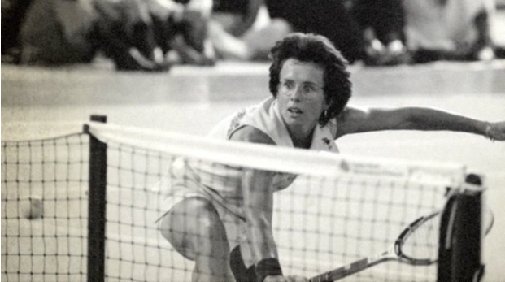
Billy Jean King made Women’s Tennis what it is today - EQUAL

